Slide 1

Batch Normalization

Slide 2
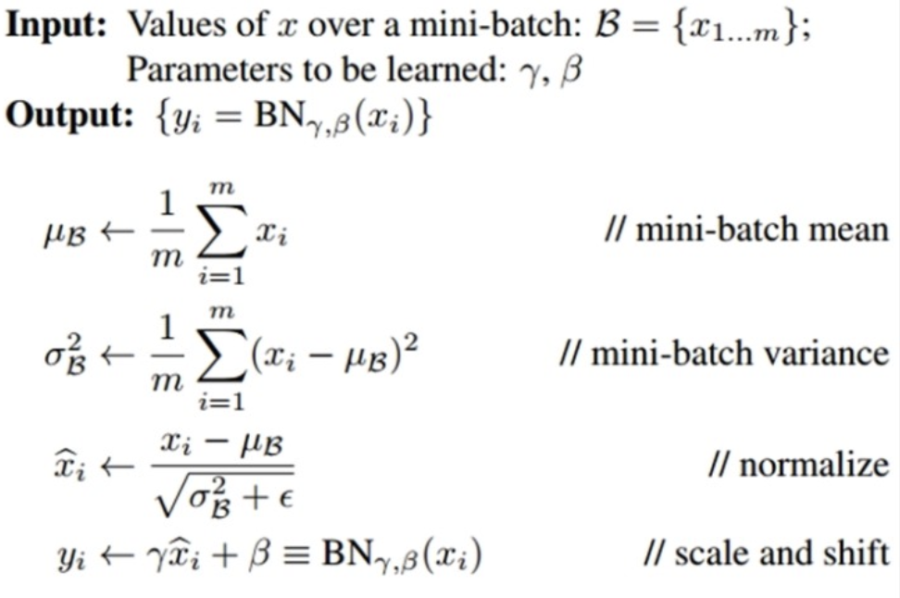

Train Period

Slide 3

Test Period

Slide 4
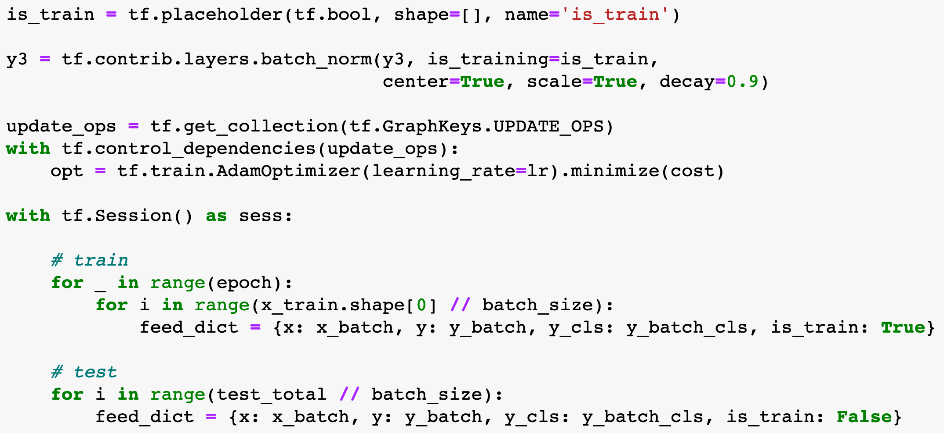
Code

Slide 6


